Slide 1
Module 8
Networking in Flutter

Slide 2
What is Networking?
Networking is the process of connecting two or more devices or nodes that can communicate with each other.
The devices or nodes can be connected by physical or wireless connections.
The purpose of networking is to transmit, exchange, or share data and resources.
Networking in Flutter is crucial for app communication with external resources like APIs, enabling fetching and sending data for real-time or user-generated content.
For example, a social media app would need to use networking to fetch user posts and comments from a server and to send new posts and comments from the user’s device to the server.
Networking also allows Flutter apps to check for internet connectivity and handle situations where the connection is lost or unstable.
This can improve the user experience by providing informative messages and taking appropriate actions based on the connection state.

Slide 3
Networking in flutter.
Networking in Flutter is the process of initiating and managing communication between a Flutter app and a remote server or API over the network.
It involves tasks such as making HTTP requests, handling responses, sending and receiving data, and handling errors.
These networking capabilities enable apps to interact with web services, fetch data from APIs, upload files, authenticate users, and perform various other network-related operations.
Mobile applications often use networking protocols like HTTP or WebSockets for sending and receiving data. Flutter offers built-in support for HTTP requests and third-party packages for advanced use cases.
One common use case is interacting with RESTful APIs, which follow the principles of REST (Representational State Transfer) architecture. Flutter provides options like HTTP and Dio packages for working with RESTful API

Slide 4
What is API?
API stands for Application Programming Interface. In simple terms, an API is like a messenger that allows different software applications to communicate and interact with each other.
Imagine you are at a restaurant and want to place an order. The waiter serves as the intermediary between you and the kitchen staff. You provide your order to the waiter, who then relays it to the kitchen. Once the food is prepared, the waiter brings it back to you.
Similarly, an API acts as a mediator between two software applications. It defines a set of rules and protocols that enable one application to access the functionalities and data of another application in a standardized and controlled manner.

Slide 5
REST API in flutter …
REST, which stands for Representational State Transfer, is an architectural style for designing networked applications.
RESTful APIs (Application Programming Interfaces) are designed based on the principles of REST
1. Stateless: Each request from a client to a server must contain all the information needed to understand and process the request. The server should not store any information about the client's state between requests. The server should not store any information about the client's state between requests.
2. Client-Server Architecture: The client and server are separate entities that communicate over a network. The client is responsible for the user interface and user experience, while the server is responsible for processing requests and managing resources.
3. Uniform Interface: RESTful APIs have a uniform and consistent interface. This includes the use of standard HTTP methods (GET, POST, PUT, DELETE) for operations on resources, resource identification through URIs (Uniform Resource Identifiers), and the representation of resources using standard formats (e.g., JSON or XML).
Notes:
https://www.scaler.com/topics/flutter-tutorial/networking-in-flutter/
https://www.freecodecamp.org/news/learn-networking-in-flutter/
https://blog.logrocket.com/networking-flutter-using-http-package/

Slide 6
REST API in flutter …
4. Resource-Based: Resources are the key abstractions in RESTful APIs. A resource can be any entity that has a unique identifier (URI) and is manipulated through representations. Resources can represent entities like users, products, or any other meaningful concept.
5. Hypermedia as the Engine of Application State : RESTful APIs should include hypermedia links in the representations returned to clients. These links guide the client in navigating the API and discovering available actions.
When developers refer to a REST API, they are talking about an API that follows the principles outlined above.
These APIs use standard HTTP methods, leverage URIs to identify resources, and exchange data in a format such as JSON or XML.
RESTful APIs have become popular for building web services due to their simplicity, scalability, and ease of use.

Slide 7
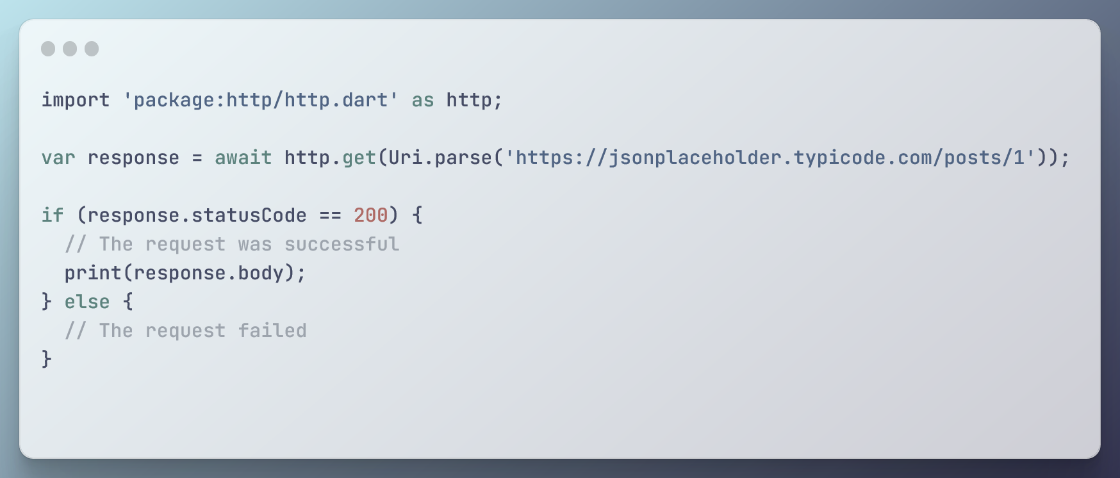
Implementing REST APIs in Flutter
To implement a REST API in Flutter, you can use one of several packages available for making HTTP requests, such as the HTTP package or the Dio package.

Slide 8
How to use REST API
REST APIs are based on the idea of using HTTP methods (GET, POST, PUT, DELETE, etc.) to perform operations on resources identified by URIs. This allows clients to interact with a server in a standardized way, using a simple and well-defined set of operations.
For example, let’s say we have a REST API for managing blog posts. We might define the following URIs and HTTP methods for interacting with the API:
GET /posts: Retrieve a list of all blog posts
POST /posts: Create a new blog post
GET /posts/1: Retrieve the blog post with ID 1
PUT /posts/1: Update the blog post with ID 1
DELETE /posts/1: Delete the blog post with ID 1
By using these URIs and HTTP methods, clients can easily interact with the server to perform CRUD (Create, Read, Update, Delete) operations on blog posts.

Slide 9


